Slide 1

PREDICTIVE MAINTANANCE & ANOMALY DETECTION FOR SINGLE STAGE SCREW AIR COMPRESSORS
Sarat Shankar
Student ID: 1175510
Thesis Supervisor: Mr. Nirav Bhatt
MASTERS IN DATA SCIENCE
LIVERPOOL JOHN MOORES UNIVERSITY

Slide 2
Agenda
Introduction/ Background
Literature Review
Problem Statement
Methodology
Results & Discussion
Conclusion and Future Recommendations
Presentation Title

Slide 3
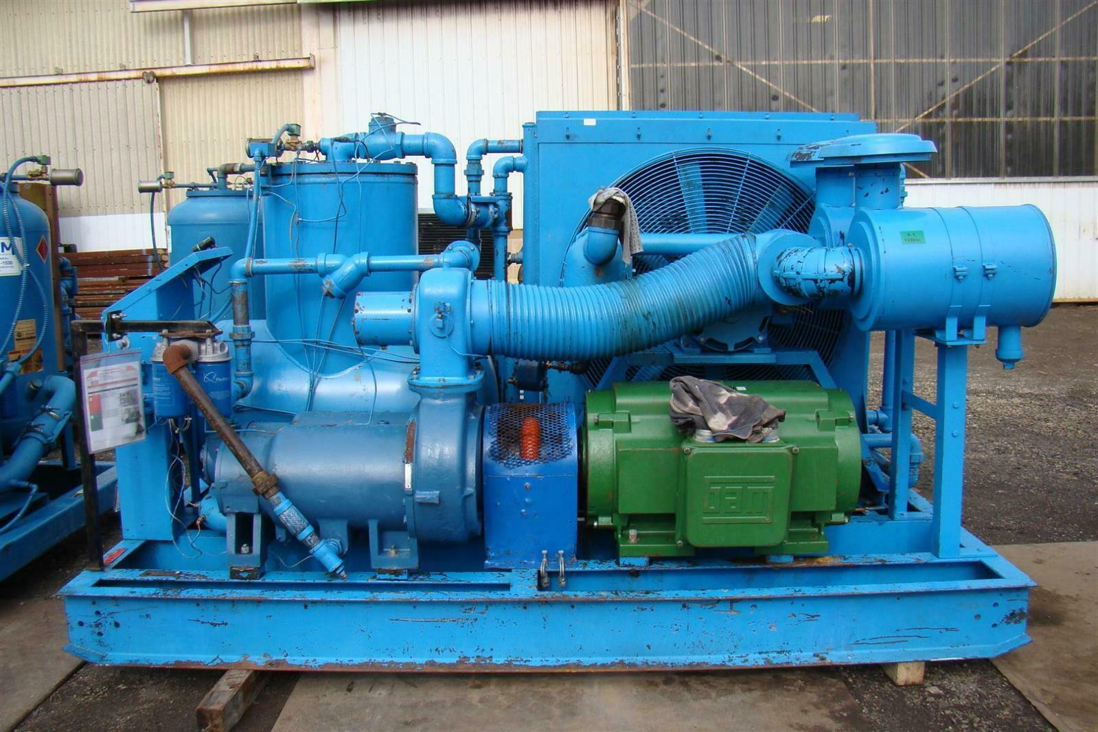
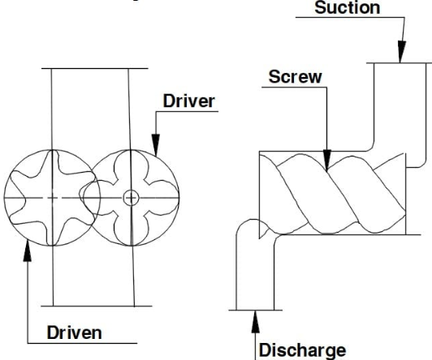
Introduction
Air compressor is an important equipment for a variety of industries which uses kinetic energy to create pressurized air. This air which is pressurized and stored in a storage air tank is used to power various industrial tools and processes.
Industrial Single Stage Air Screw Compressor
Industrial maintenance refers to all activities performed to ensure that the equipment, machinery, and infrastructure of a production system operate correctly and without interruptions.
Over the period of time, with change in tools, technology and processes , the maintenance practices also changed from reactive to preventive to predictive
In this Study I am focusing on Predictive Maintenance and Anomaly detection for Industrial Single stage Air Compressor.

Slide 4
“Based on current refinery economics, says Every 1% gain in availability is worth $84 million of additional margin capture per year in a typical 200,000 bpd refinery”
Doug White, Emerson Industry Expert

Slide 5
Literature review
Lei Y Et al,2020
Ayam Alkazam,2020
Applications of machine learning to machine fault diagnosis
Evaluation of Adaptive random forest algorithm for classification of evolving data stream
Authors (Peter Poor, Davide Zenesik and Josef Basl, 2019)
Historical Overview of Maintenance Management Strategies
Doan Ngoc Chi Nam Et al,2019)
Mohammed Amine Moustakim Et al,2020
Coordinate e-business applications
Prediction of electric power and load forcasting using LSTM technique for EMS

Slide 6
Problem Statement
Unplanned Downtime is a big issue for any manufacturing industry; there is a huge cost burden for each unplanned downtime, this has become a necessity for Manufacturing companies.
Most of the studies in this area of Predictive Maintenance for Compressors systems operate on historical data but fail to implement real-time monitoring and anomaly detection mechanisms which can also caters to live streaming data coming from compressors while effectively adapting to concept drift scenarios.
Also, there are limited studied available which focuses on easy to implement User Interface for condition Monitoring , forecasting for key parameters and anomaly detection which can we used by medium and small-scale industries.
Aim: of this research is to develop a system which can detect anomalies in Single Stage Screw Air Compressor where data is coming from sensors in realtime, additionally aim is to implement condition monitoring and forecasting of critical operational parameters using simple to use UI framework

Slide 7
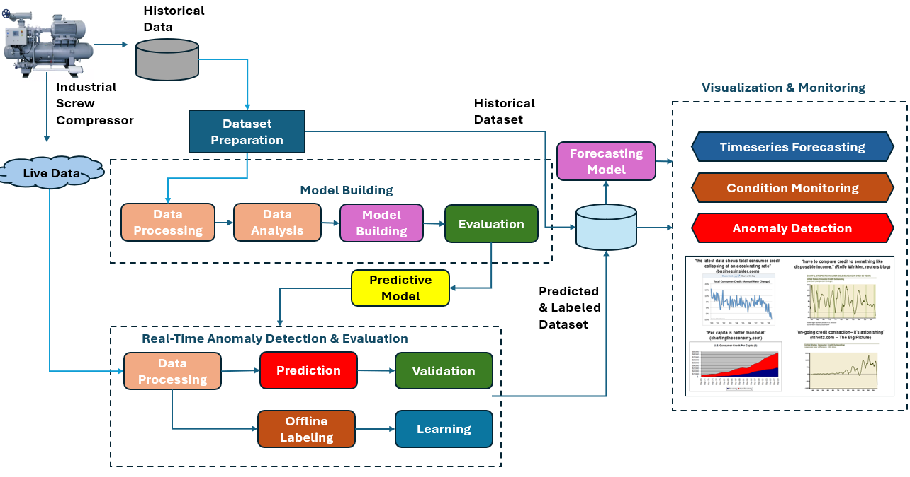
Methodology
In this study I am using Adaptive Random Forest (ARF) to monitor real-time data coming from sensors mounted on compressors and predict presence on any anomaly in received batch of data.
Adaptive Random Forest (ARF) is a modified version of the classic Random Forest algorithm, tailored to handle continuously evolving data preventing concept drifts and supports live streams of data in real-time environments.
For Forecasting critical parameters like Power Consumption , Efficiency etc I am experimenting with Long Short-Term Memory (LSTM) model.

Slide 8
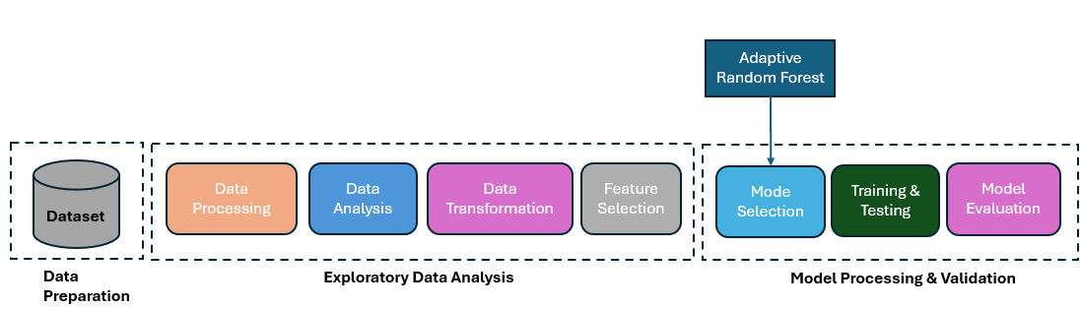
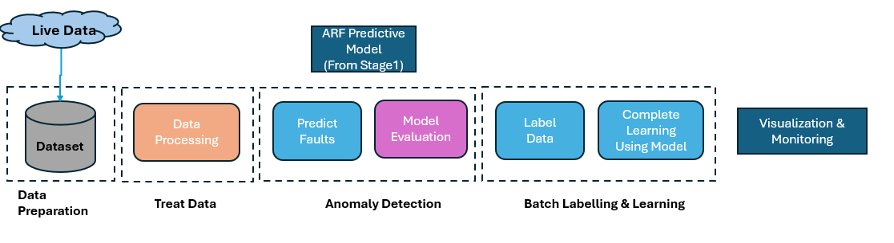
Structure of Experiment
This Experiment is divided into 2 stages:
Stage 1 : The objective here is to initialize and develop a predictive model using historical compressor sensor data. This involves a workflow where the data is first cleaned, processed, and analyzed. Key features are then selected based on relevance and impact, forming the foundation for building an effective and accurate model.
Stage 2 : The objective here is to fetch Live Sensor data coming from compressor and pass data to a workflow where the data is first cleaned, processed and model from Stage 1 is used to predict anomalies, after this data goes to a holding area where data is labelled manually and then model is trained for new received batch.

Slide 9
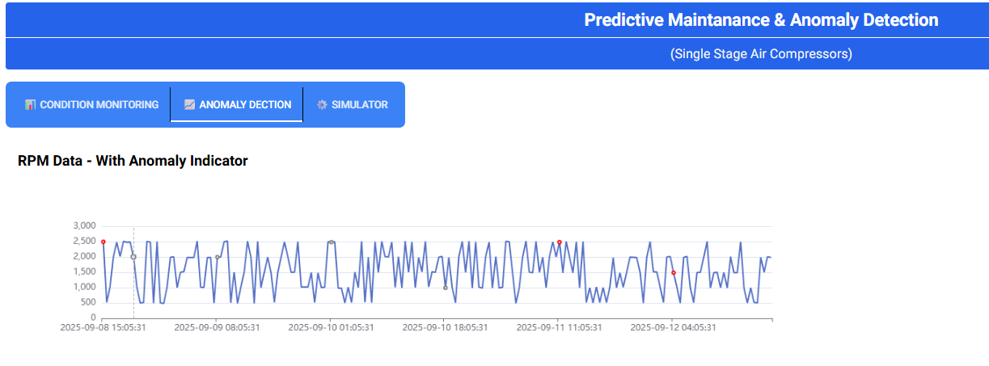
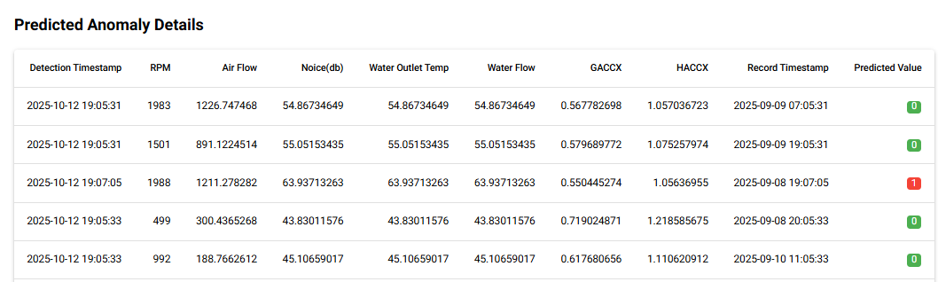
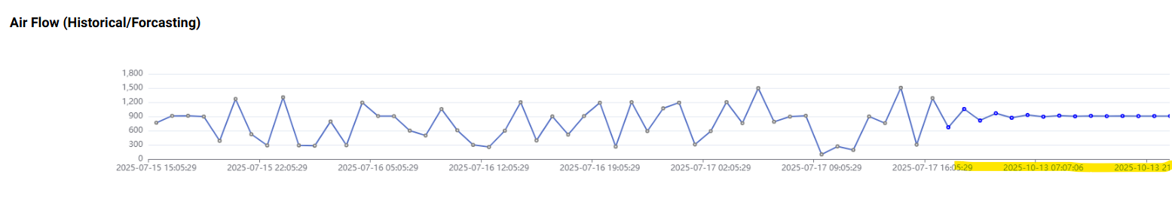
Simple to Use UI Framework
These anomalies are visualized on a line chart, with the detected fault points highlighted in red.
Also, anomalies details are shown in a tabular format
Condition monitoring and forecasting insights are presented through interactive charts and plots within the user interface, enabling clear and intuitive visualization of system performance and trends.

Slide 10
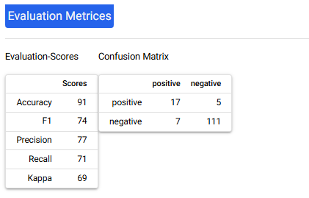
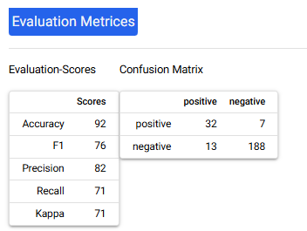
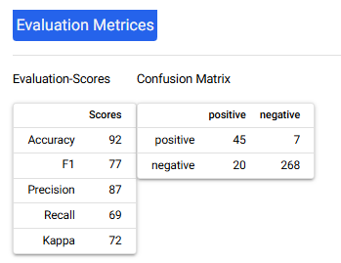
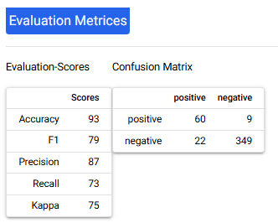
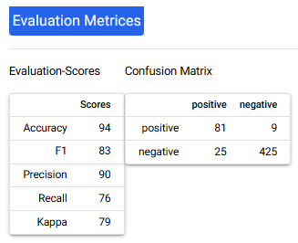
Results & Discussions
During creation of model for historical data, the Adaptive Random Forest model shows high precision when evaluated with test set, which mean it rarely raised false alarms. However, its recall is lower, so it may miss some actual faults, which could be risky depending on the actual implementation .
Detailed tuning should be implied to improve recall without sacrificing precision.
Batch 1
Batch 2
The steady improvement in performance metrics indicates that the model is effectively adjusting to live data streams. It's important to maintain ongoing surveillance in further studies for concept drift.
Considering the positive performance trend, regularly retraining the model with the latest batch data appears to be an effective strategy. Continuing this retraining cycle will help sustain and potentially enhance model accuracy over time.
Batch 3
Batch 4

Slide 11
Conclusion & Recommendations
This experiment shows how combining machine learning with modern data collection tools and easy-to-use visualizations can improve predictive maintenance with uses Adaptive Random Forest algorithms to detect faults in bearing systems of Industrial Screw Air Compressor by analyzing live data streams in real time. It also explores how LSTM models can be used for time series forecasting to monitor the health of industrial air compressors. By using multiple sensor inputs—like temperature, airflow, RPM, and vibration—the system can continuously track performance, spot unusual behavior, and detect early signs of problems. This contributes to smarter, data-driven maintenance and helps reduce downtime and improve efficiency.
Future Recommendations:
Next step should be to conduct this experiment on a physical Industrial Air Compressor where a proof-of-concept visualization can we used by maintenance engineers to provide feedback on models’ performance.
Model should undergo test for Concept Drift; more testing and parameter tuning is required to improve the robustness and improve recall without sacrificing precision.
Based on fruitfulness of further experiment , we can integrate Alert system with this system where an alert in terms of email or SMS can be sent to user directly.
This experiment can also be expanded to dynamically assign new labels within the system by tagging specific timeframes when physical failures occur. This approach enables the model to continuously learn from real-world events and improve its ability to predict
similar failures in the future, enhancing its adaptability and long-term accuracy.

Slide 12




Thank you
Sarat Shankar

